Slide 1
Fractal Dimension of the Diffusion-limited Aggregation (DLA) Model On and Off Lattice
Jacky Lin
Bucknell University
May 6, 2021
Notes:
Hi everyone. My name is Jacky
My topic is about fractal dimension of the diffusion limited aggregation model on and off lattice

Slide 2
Contents
Introduction
Model
On-Lattice Rules
Off-lattice rules
Result

Slide 3
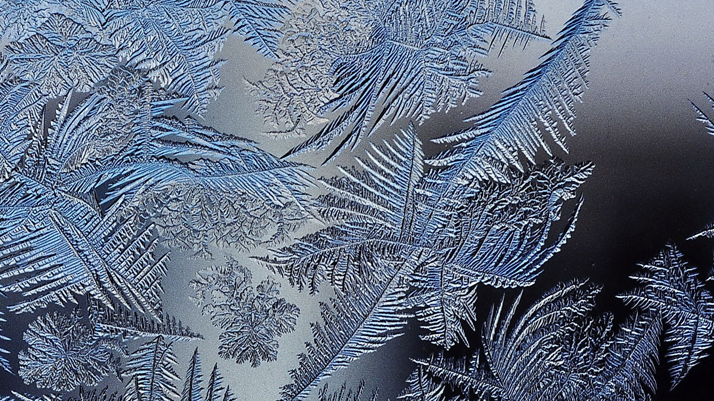
What is Fractal Growth?
There are variety of complicated patterns in nature.
Reproducible by modelling with fractal growth model.
Fractal growth processes are a class of phenomena which produce self-similar, disordered objects in the course of development far from equilibrium¹.
Notes:
The diffusion-limited aggregration model is a subfield of fractal growth model. So what is fractal growth?
There are variety of complicated pattern in the nature. Most of them is reproducible by fractal growth model.
It is a class of phenomena which produce self-similar disordered objects in the course of development far from equilibrium.

Slide 4
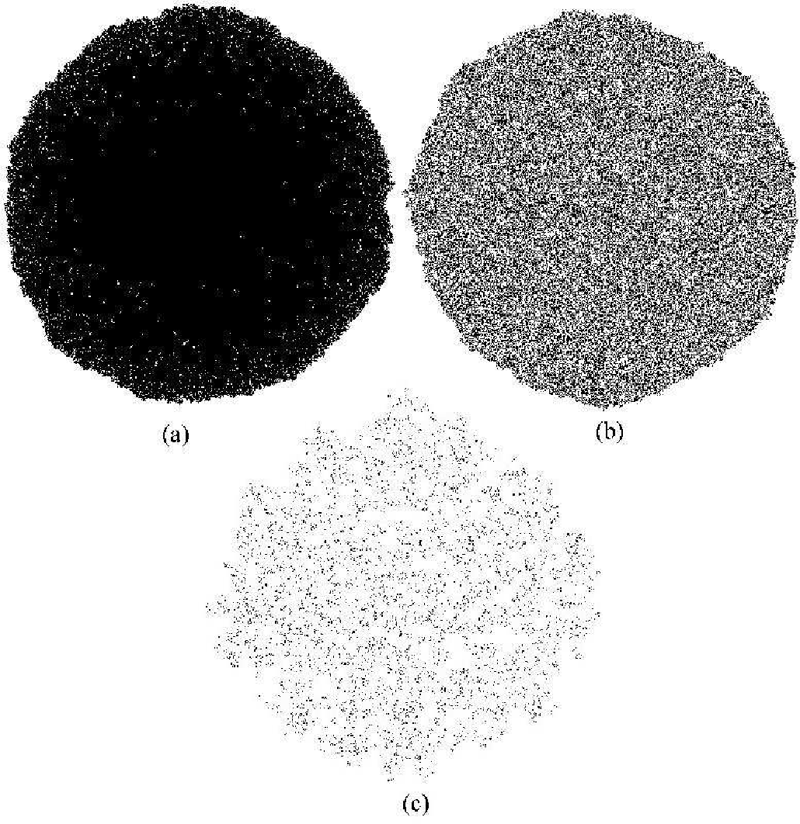
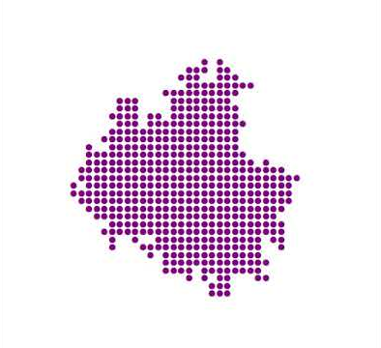
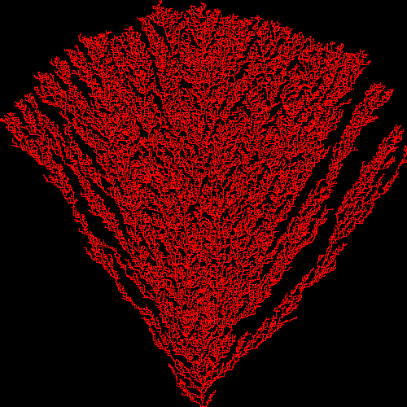
Such as …
The Eden model
grow by random accumulation of material on their boundary
The William and Bjerknes Model:
a stochastic model simulating the spread of cancer cells.
The Ballistic aggregation models
allows particles to attach themselves to the aggregate if a neighboring lattice point is occupied¹
1. Ballistic Aggregation Models, pages 121–141. Springer New York, New York, NY, 2008.
Notes:
Here I list some of the fractal growth model, including eden model, william and bjerknes model and ballistic aggregation model.

Slide 5
Previous Work
The initial model of diffusion-limited aggregation was proposed by Witten and Sander in 1983¹. Studies following this fundamental paper can be categorized into several ways:
Simulation on certain particles or substances using this model, such as lead dendrites².
Simulation of the diffusion-limited aggregation model on different surfaces, like a curved surface³.
DLA model in multi-dimensions, such as in three dimensions⁴.
Investigating some scaling characteristics of the model⁵.
T. A. Witten and L. M. Sander. Diffusion-limited aggregation. Phys. Rev. B, 27:5686–5697, May 1983.
M. Abdel Baki and L. Badr. Electroless, diffusion limited aggregation of lead dendrites. Chaos, Solitons & Fractals, 143:110586, 2021.
Jaehyuk Choi, Darren Crowdy, and Martin Bazant. Diffusion-limited aggregation on curved surfaces. EPL, 91, 03 2010.
L. M. Sander, Z. M. Cheng, and Roy Richter. Diffusion-limited aggregation in three dimensions. Phys. Rev. B, 28:6394–6396, Dec 1983.
Isadora R. Nogueira, Sidiney G. Alves, and Silvio C. Ferreira. Scaling laws in the diffusion limited aggregation of persistent random walkers. Physica A: Statistical Mechanics and its Applications, 390(23):4087–4094, 2011
Notes:
DLA model is also an example of fractal growth. It is first proposed by witten and sander in 1983. Studies following this work can be categorized into many ways.
some people using this model to simulate on certain substance, like lead dendrites, some people simulate DLA on different surfaces such as a curved surface, some simulate DLA in different dimensions such as a 3-d space, others look into some characteristics like a scaling laws with in this model.

Slide 6
Contents
Introduction
Model
On-Lattice Rules
Off-lattice rules
Result
Notes:
There are two set of rules. On and off lattice rules.

Slide 7
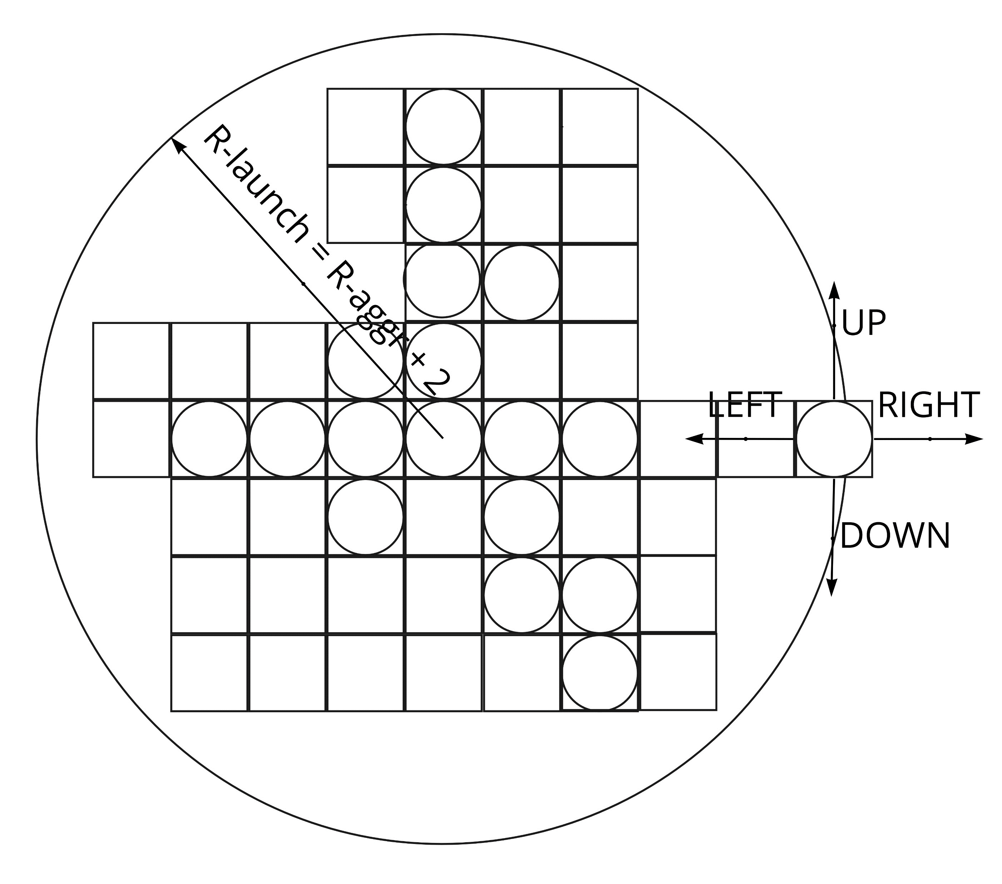
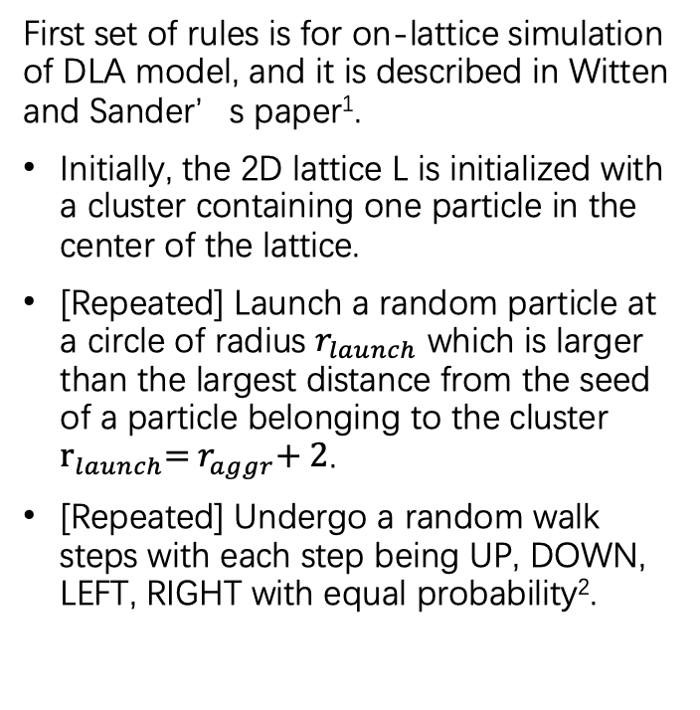
On-Lattice Rules
First set of rules is for on-lattice simulation of DLA model, and it is described in Witten and Sander’s paper¹.
Initially, the 2D lattice L is initialized with a cluster containing one particle in the center of the lattice.
[Repeated] Launch a random particle at a circle of radius $r_{launch}$ which is larger than the largest distance from the seed of a particle belonging to the cluster ${\text{r}}_{launch}\text{= }r_{aggr}\text{+ 2}$.
[Repeated] Undergo a random walk steps with each step being UP, DOWN, LEFT, RIGHT with equal probability².
T. A. Witten and L. M. Sander. Diffusion-limited aggregation. Phys. Rev. B, 27:5686–5697, May 1983.
Harvey Gould, Jan Tobochnik, and Don E. Harrison. An introduction to computer simulation methods: Applications to physical systems, part 1 and part 2. Computers in Physics, 2(1):90–91, 1988.
Notes:
I will introduce the on lattice rules first. This set of rules is described in the witten and sander's paper.
Initially, the 2D lattice L is initialized with a cluster containing one particle in the center of the lattice.
As you can see from the graph on the right, Launch a random particle at a circle of radius which is larger than the largest distance from the seed of a particle belonging to the cluster Undergo a random walk steps with each step being UP, DOWN, LEFT, RIGHT with equal probability.

Slide 8
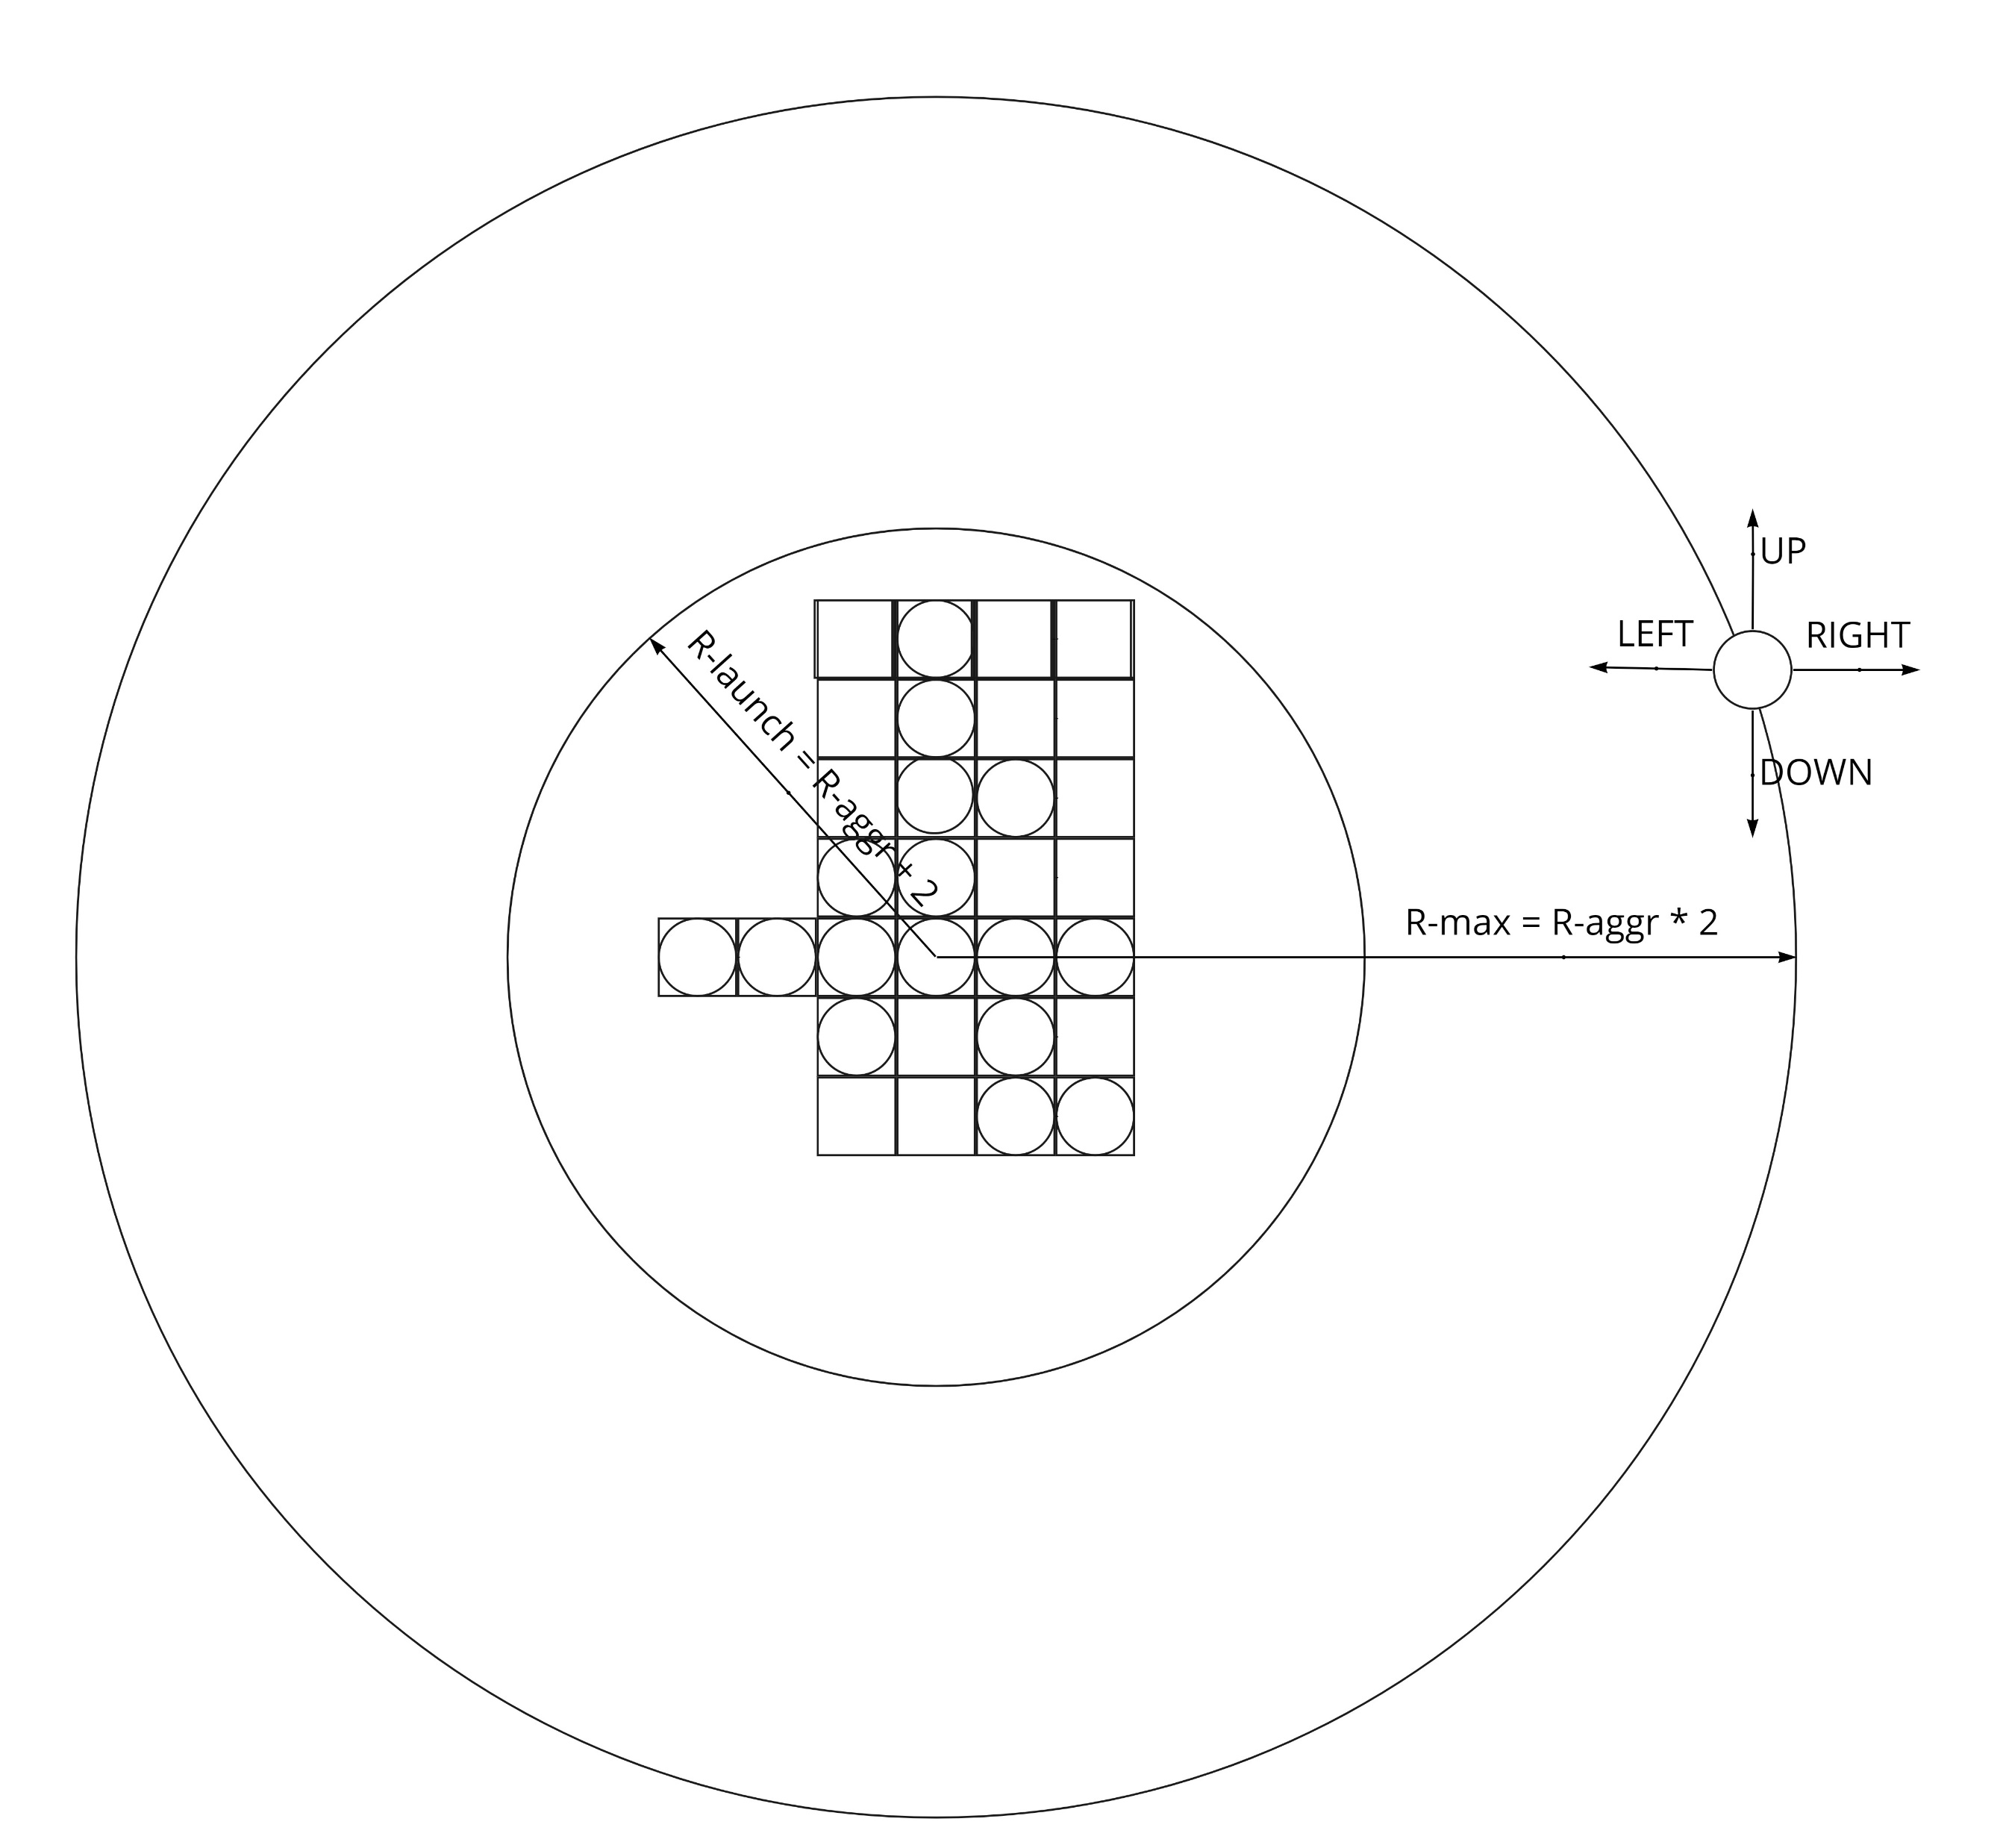
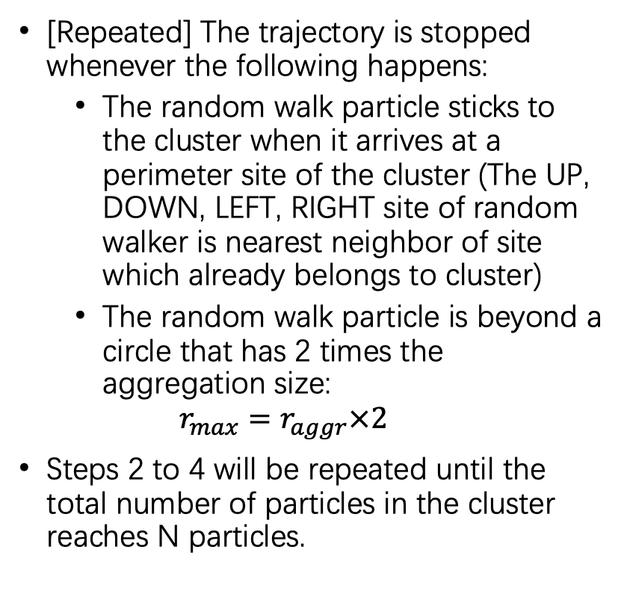
On-Lattice Rules
[Repeated] The trajectory is stopped whenever the following happens:
The random walk particle sticks to the cluster when it arrives at a perimeter site of the cluster (The UP, DOWN, LEFT, RIGHT site of random walker is nearest neighbor of site which already belongs to cluster)
The random walk particle is beyond a circle that has 2 times the aggregation size:
$$r_{max}=r_{aggr}×2$$
Steps 2 to 4 will be repeated until the total number of particles in the cluster reaches N particles.
Notes:
[Repeated] The trajectory is stopped when either
The random walk particle sticks to the cluster when the UP, DOWN, LEFT, RIGHT site of random walker is nearest neighbor of site which already belongs to cluster
or
The random walk particle is beyond a circle that has 2 times the aggregation size, which is demonstrate on the graph. In this case the particle is nearly out of range, and we are about to discard it.
Steps 2 to 4, indicated by repeated label will be repeated until the total number of particles in the cluster reaches N particles.

Slide 9
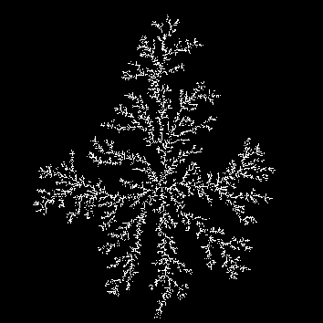
Cluster with 27223 Particles
Notes:
Here is an example of my simulation with 27 thousand particles.

Slide 10
Contents
Introduction
Model
On-Lattice Rules
Off-lattice rules
Result

Slide 11
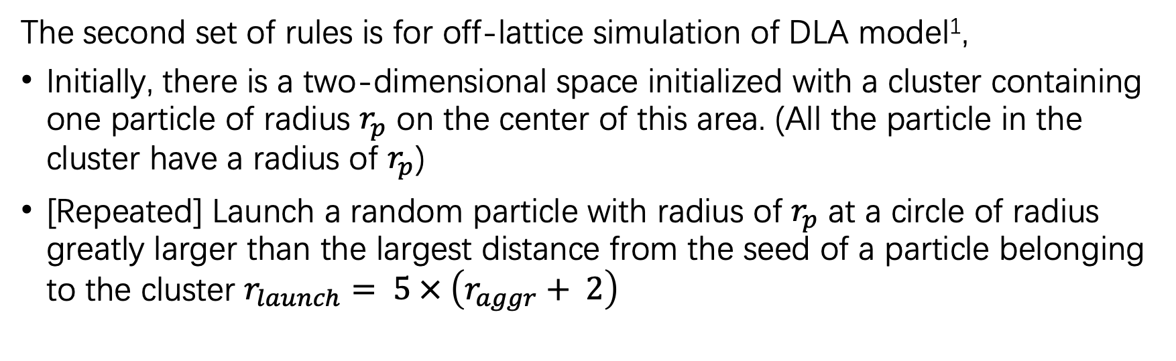
Off-Lattice Rules
The second set of rules is for off-lattice simulation of DLA model¹,
Initially, there is a two-dimensional space initialized with a cluster containing one particle of radius $r_{p}$ on the center of this area. (All the particle in the cluster have a radius of $r_{p}$)
[Repeated] Launch a random particle with radius of $r_{p}$ at a circle of radius greatly larger than the largest distance from the seed of a particle belonging to the cluster $r_{launch}= 5 × \left(r_{aggr}+ 2\right)$
Isadora R. Nogueira, Sidiney G. Alves, and Silvio C. Ferreira. Scaling laws in the diffusion limited aggregation of persistent random walkers. Physica A: Statistical Mechanics and its Applications, 390(23):4087–4094, 2011
Notes:
The off lattice rules is a bit different from on lattice one. Initialization step would thus initialize with a particle of radius r_p. actually, in this set of rules, all particles would have a radius of r_p. At the launch step, we are launching from a circle 5 times the aggregation size instead of small increase from aggregation size.

Slide 12
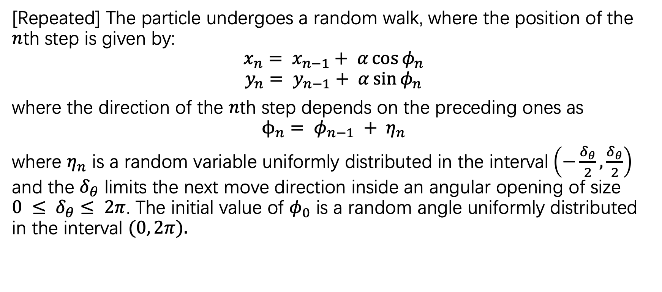
Off-Lattice Rules
[Repeated] The particle undergoes a random walk, where the position of the $n$th step is given by:
$$x_{n}= x_{n−1}+ α\cos{φ_{n}}$$
$$y_{n}= y_{n−1}+ α\sin{φ_{n}}$$
where the direction of the $n$th step depends on the preceding ones as
$$ϕ_{n}= φ_{n−1} + η_{n}$$
where $η_{n}$ is a random variable uniformly distributed in the interval$\left(−\frac{δ_{θ}}{2},\frac{δ_{θ}}{2}\right)$ and the $δ_{θ}$ limits the next move direction inside an angular opening of size $0 ≤ δ_{θ}≤ 2π$. The initial value of $φ_{0}$ is a random angle uniformly distributed in the interval $(0, 2π).$
Notes:
The random walking step is quite different.
In here, every position is depending on preceding position plus some step length alpha times a random angle.
The random angle is also depending on previous angle with some small random change, which is limited by a fixed angular opening size.
The initial value of random angle would be randomly obtain from 0 to 2pi

Slide 13
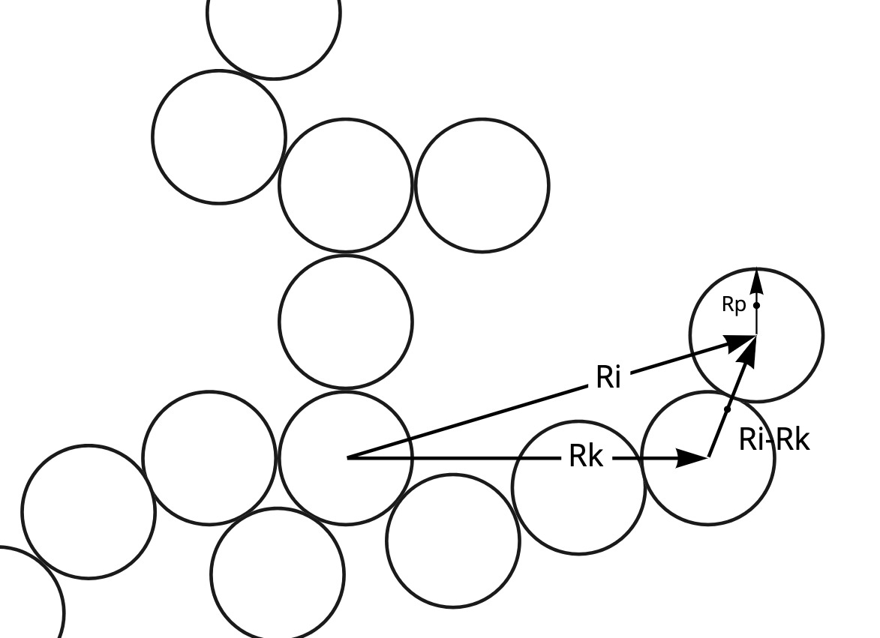
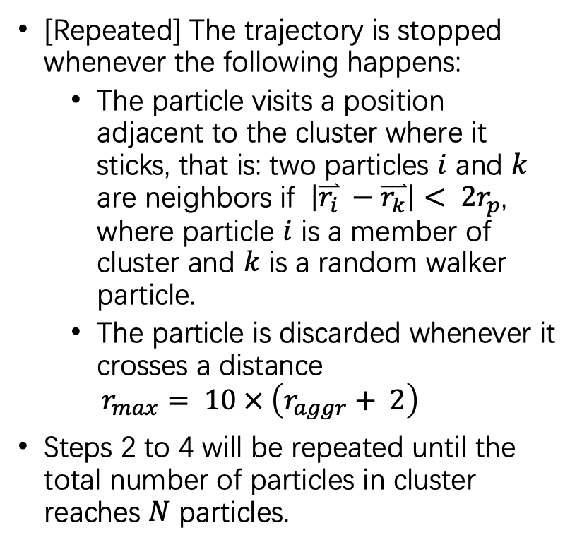
Off-Lattice Rules
[Repeated] The trajectory is stopped whenever the following happens:
The particle visits a position adjacent to the cluster where it sticks, that is: two particles $i$ and $k$ are neighbors if $\left|\overset{⃑}{r_{i}} −\overset{⃑}{r_{k}}\right|< 2r_{p}$, where particle $i$ is a member of cluster and $k$ is a random walker particle.
The particle is discarded whenever it crosses a distance
$$r_{max}= 10 × \left(r_{aggr}+ 2\right)$$
Steps 2 to 4 will be repeated until the total number of particles in cluster reaches $N$ particles.
Notes:
The stop of trajectory has the same idea as we saw in the on-lattice rules. But there are variations
first we determine whether a particle is close to a cluster by calculate the distance of all particles belonging to the cluster with the random walker, if any of these distances is less than the 2 times the radius of the particle, the random walker will stick to the cluster.
Another difference is that a random walker will discard in a much larger distance
All the steps labeled with repeated will repeat which is the same as on lattice rules.

Slide 14
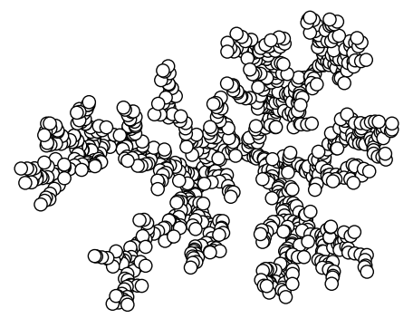
Cluster with 10000 Particles
Notes:
Here is an example of cluster with 10 thousand particle with off-lattice simulation rules.

Slide 15
Contents
Introduction
Model
On-Lattice Rules
Off-lattice rules
Result
Notes:
The result part will focus on the fractal dimension under different cirsumstance

Slide 16
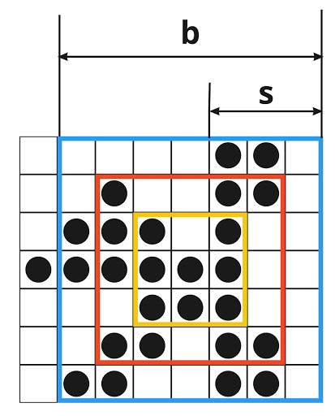
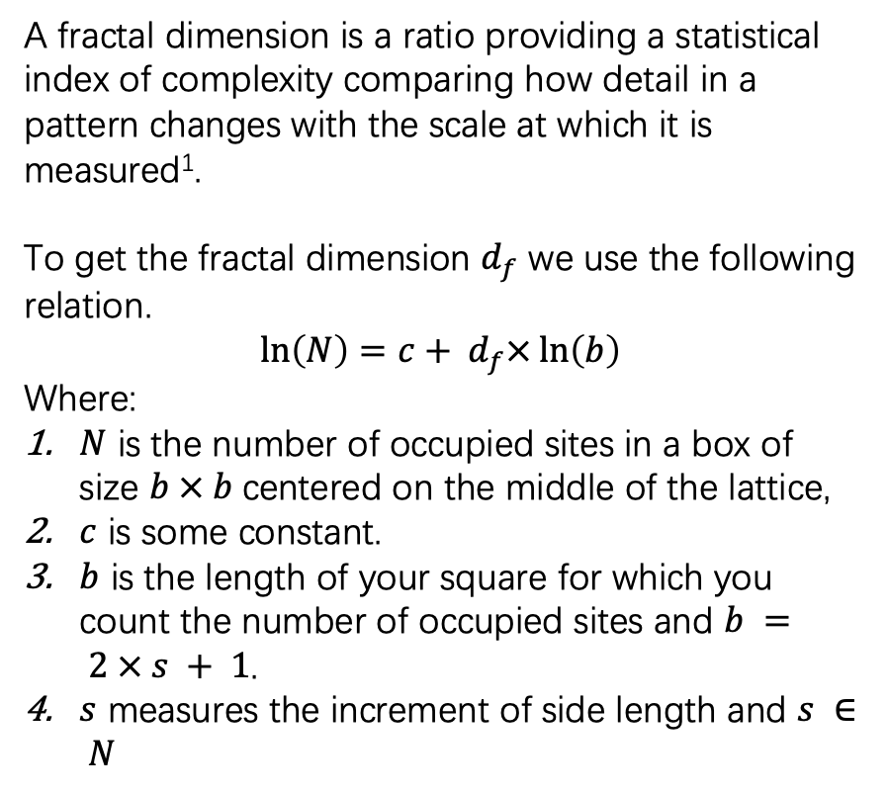
Fractal Dimension On-Lattice
A fractal dimension is a ratio providing a statistical index of complexity comparing how detail in a pattern changes with the scale at which it is measured¹.
To get the fractal dimension $d_{f}$ we use the following relation.
$$\ln\left(N\right)=c+ d_{f}×\ln\left(b\right)$$
Where:
$N$ is the number of occupied sites in a box of size $b × b$centered on the middle of the lattice,
$c$ is some constant.
$b$ is the length of your square for which you count the number of occupied sites and $b = 2 × s + 1$.
$s$ measures the increment of side length and $s ∈ N$
“Fractal dimension,” https://en.wikipedia.org/wiki/Fractal_dimension (2021)
Notes:
Let's define the fractal dimension first. A fractal dimension is a ratio providing a statistical index of complexity comparing how detail in a pattern changes with the scale at which it is measured.
We use a linear relationship to obtain the fractal dimension.
N is the number of particle within a box
c is the constant
b is the length of the box, which depends on s
s is the increment of the side length.
for example, as you can see from the graph, we increse s from 1 to 3, and b changes from 3 to 7, in the box of 3 *3, we have N be 8.

Slide 17
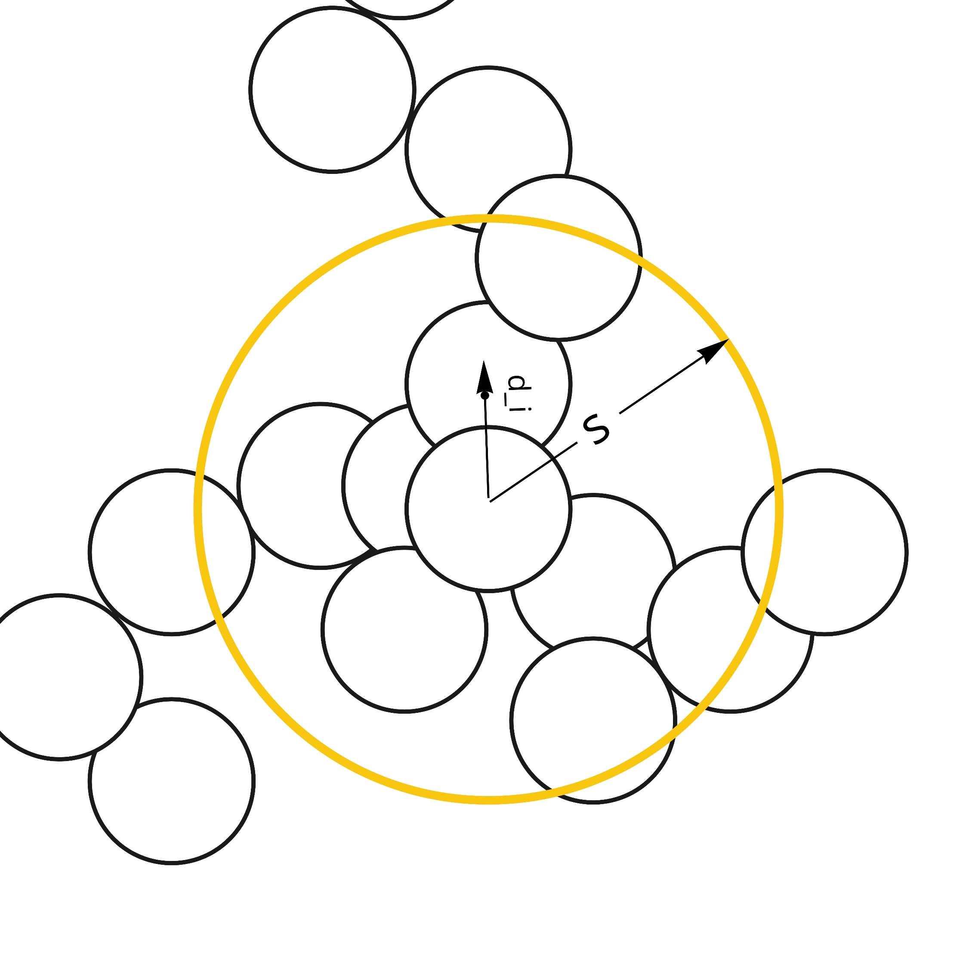
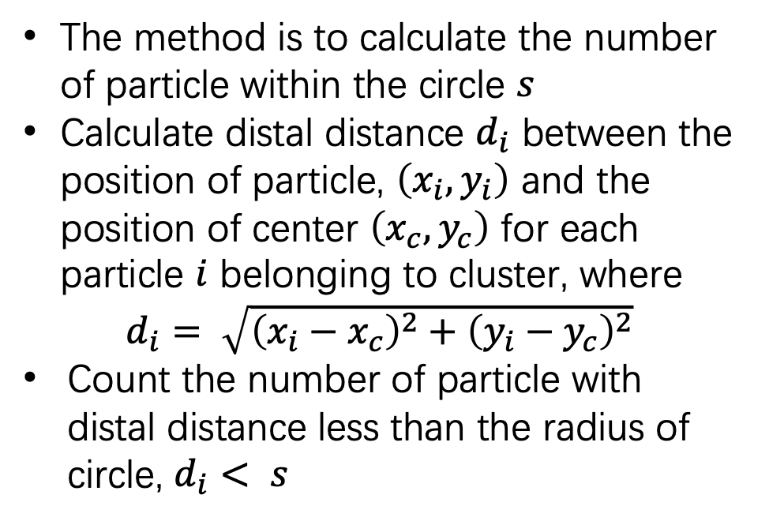
Fractal Dimension Off-Lattice
The method is to calculate the number of particle within the circle $s$
Calculate distal distance $d_{i}$ between the position of particle, $\left(x_{i}, y_{i}\right)$ and the position of center $\left(x_{c}, y_{c}\right)$ for each particle $i$ belonging to cluster, where
$d_{i}= \sqrt{{\left(x_{i}−x_{c}\right)}^{2}+{\left(y_{i}−y_{c}\right)}^{2}}$
Count the number of particle with distal distance less than the radius of circle, $d_{i}< s$
Notes:
The off lattice fractal dimension use the same linear relation to obtain fractal dimension. but there some differences:
The range to count the number of particle is determined by a circle with radius s instead of a box
The number of N would be count by calculating all the distance between the center of all particles to the center of cluster and count the number of particle have a distal distance less than the radius of the circle.

Slide 18
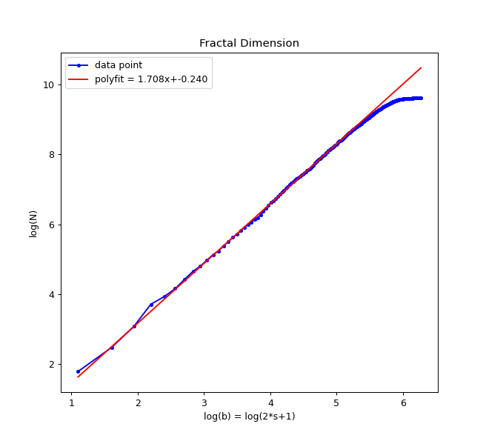
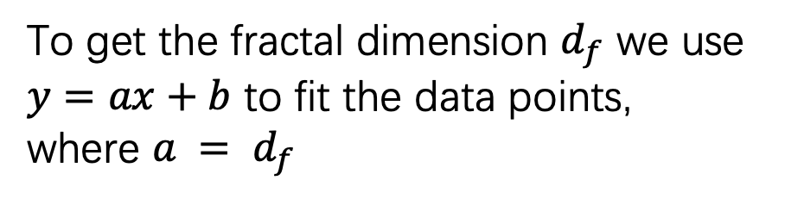
Fractal Dimension
To get the fractal dimension $d_{f}$ we use $y=ax+b$ to fit the data points, where $a = d_{f}$
Notes:
After we use the method to measure the fractal dimension, we would obtain some plot like this. Then we use a linear fit to obtain some function y = ax + b where the a would be our fractal dimension.

Slide 19
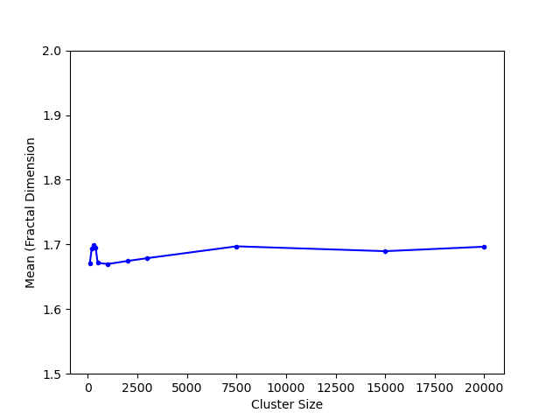
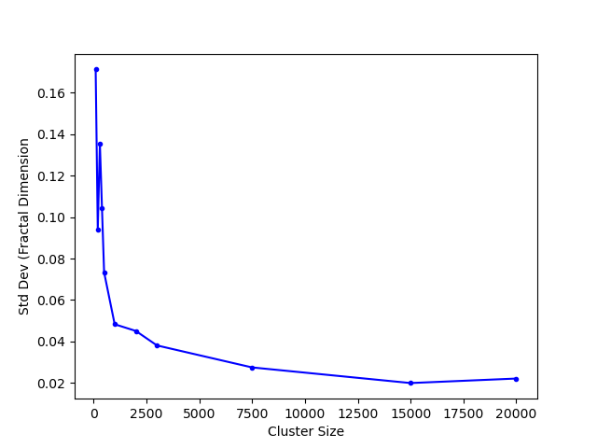
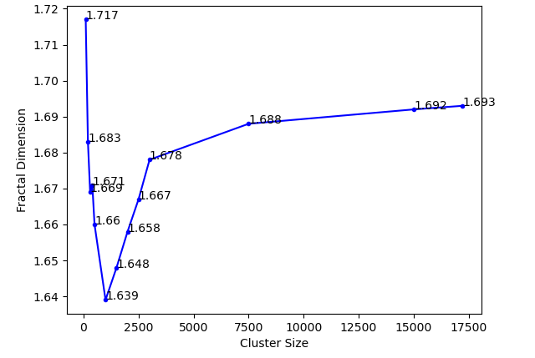
Cluster Size
(a) Fractal Dimension vs. Final Cluster Size
(b) Mean Fractal Dimension vs. Final Cluster Size
(c) Standard Deviation (Fractal Dimension) vs. Final Cluster Size
The mean of fractal dimension for all cluster size is relatively the same
The smaller cluster size with high standard deviation is not reliable
For very large clusters, fractal dimension levels off, that means that we are no longer fighting finite size effects but that we reach a bulk value.
Thus, the cluster size at the end of simulation with 3000 particles is in the leveled off region, so the extra computational time is not needed.
Notes:
I measure the fractal dimension for cluster size at the end of simulation from 100 to 20000.
I found that also the mean fractal dimension is roughly the same, the smaller cluster size would have a larger standard deviation.
For large cluster size fractal dimension levels off that means we are no longer fighting finite size effects but that we reach a bulk value.
For the cluster size of 3000, it is in the leveled off region, so the extra computational time is not needed.

Slide 20
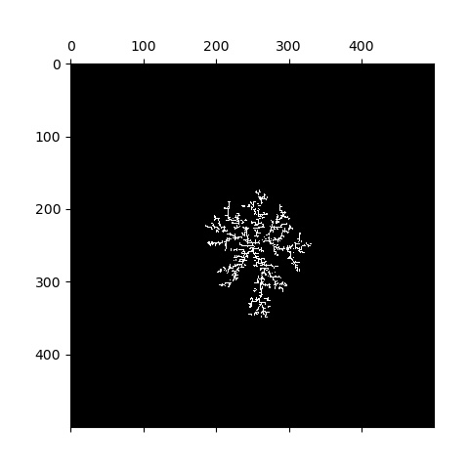
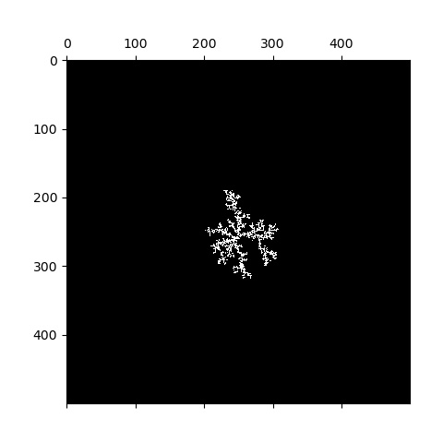
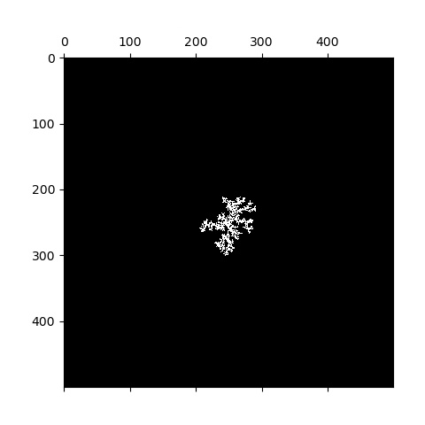

Stickiness
Stickiness refers to the probability that the random walker would stick to the cluster.
The lower the stickiness, the more condensed these clusters are.
(d) stickiness = 0.01
(b) stickiness = 0.25
(c) stickiness = 0.1
(a) stickiness = 1
FIG: Clusters with Different Stickiness
Notes:
Another feature is the stickiness which refers to the probability that the random walker would stick to the cluster.
As you can see from the graph below from left to right, we can see that the lower the stickiness, the more condensed these clusters are.

Slide 21
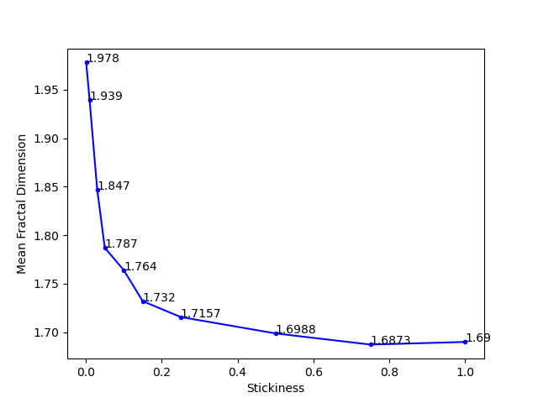
Stickiness
The lower the stickiness, the higher the fractal dimension
Increase from right to left.
Close to 2-dimensional shape, such as square or circle
Notes:
I fond that The lower the stickiness, the higher the fractal dimension
The fractal dimension increases from right to left as the stickiness deceases
At a low stickiness the fractal dimension is close to 2, which indicate that it is like a 2-dimensional shape, such as square or circle

Slide 22
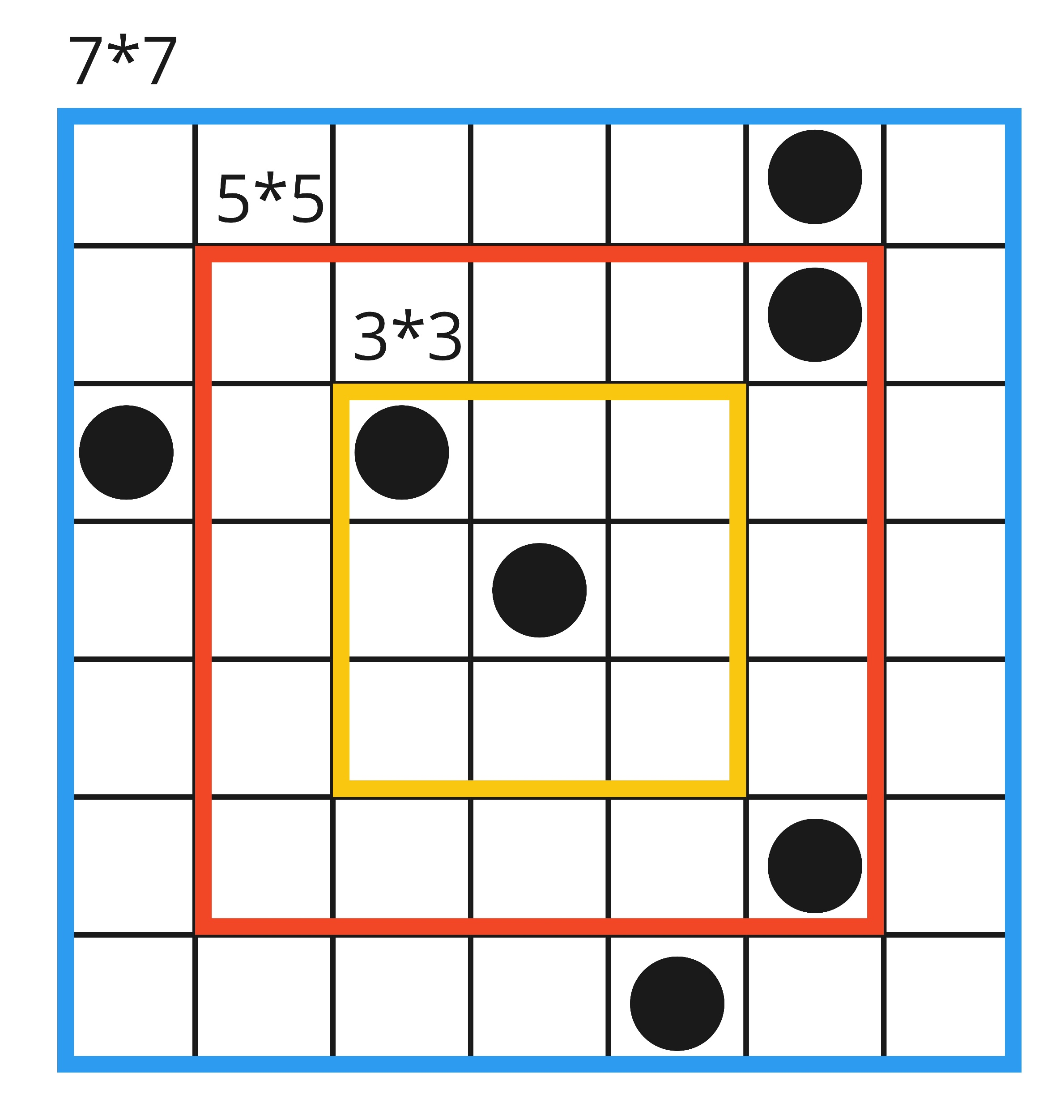
Neighboring Ranges
Neighboring range refers to the range that determines whether a random walker is near a cluster.
Notes:
Another feature is about Neighboring range which refers to the range that determines whether a random walker is near a cluster.

Slide 23
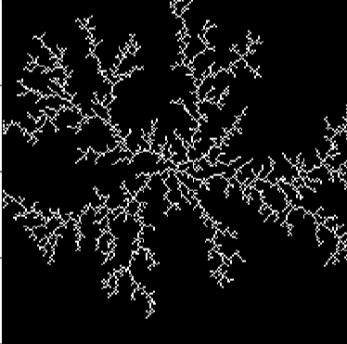
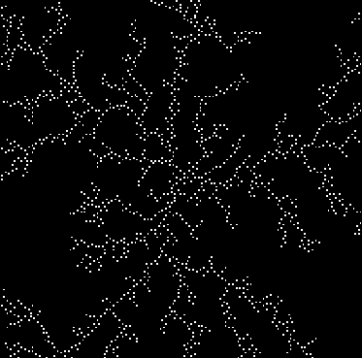
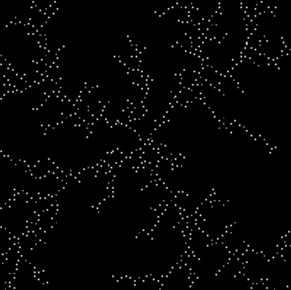
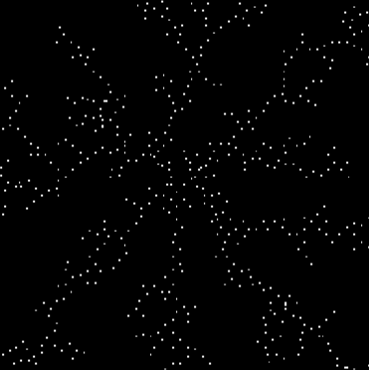
Neighboring Ranges
(a) neighbor range=3
(b) neighbor range=5
(c) neighbor range=7
(d) neighbor range=9
FIG. 6: Clusters with Neighboring Range
When the neighboring range is small, the particles in the cluster are closer to each other, while when we increase the neighboring range of the particles in the cluster, the gap between particles increases
The image with a higher neighboring range is dimmer than the image with a lower neighboring range.

Slide 24
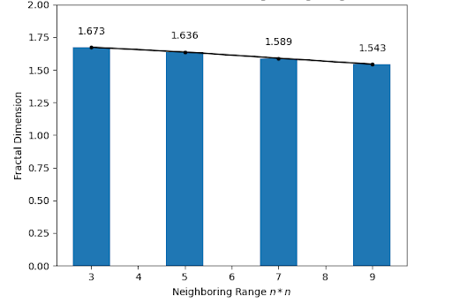
Neighboring Ranges
A negative linear-like relationship between the decreases of fractal dimension and increases of neighboring ranges.

Slide 25
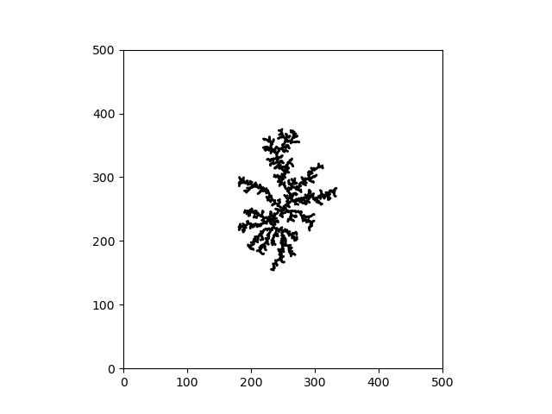
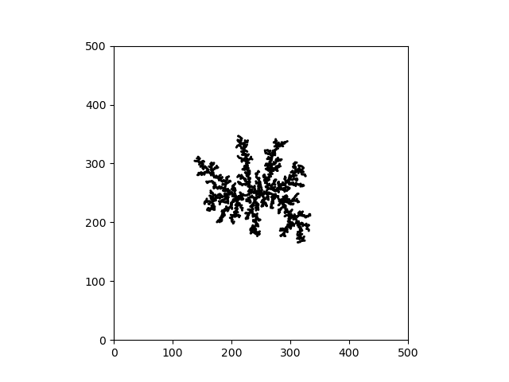
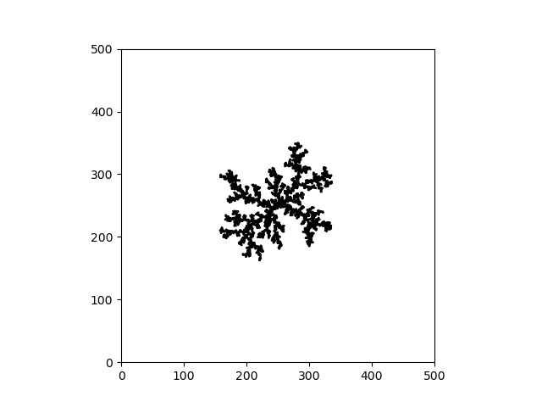
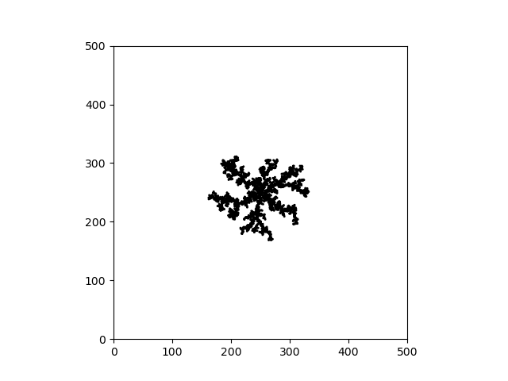
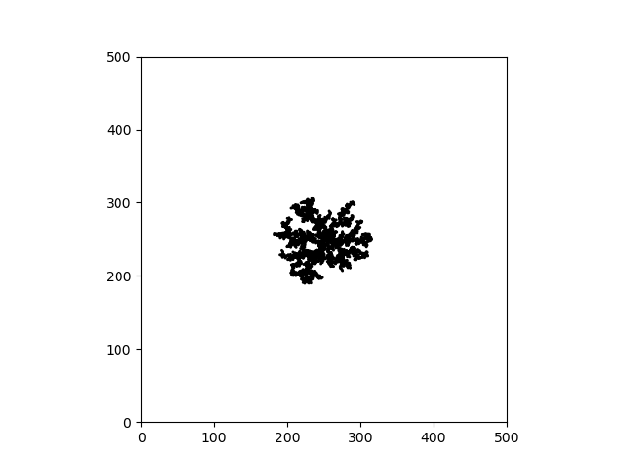
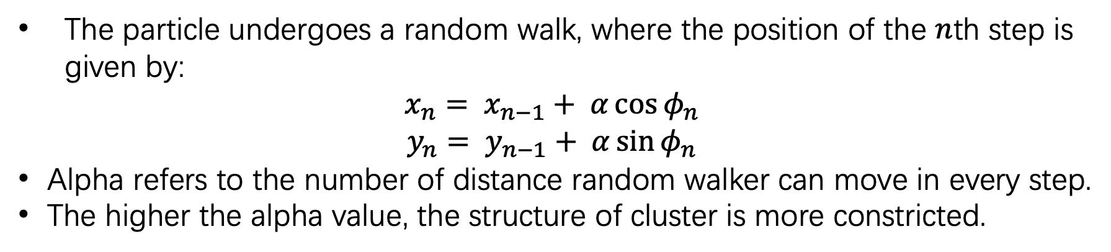
Alpha
The particle undergoes a random walk, where the position of the $n$th step is given by:
$$x_{n}= x_{n−1}+ α\cos{φ_{n}}$$
$$y_{n}= y_{n−1}+ α\sin{φ_{n}}$$
Alpha refers to the number of distance random walker can move in every step.
The higher the alpha value, the structure of cluster is more constricted.
(a) α = 1
(b) α = 2
(c) α = 3
(d) α = 4
(e) α = 5
FIG. 8: Clusters with Various Alpha
Notes:
Recap from the rules of offlattice simulation, there is a alpha which refers to the number of distance random walker can move in every steps.
As we can see from the cluster from left to right The higher the alpha value, the structure of cluster is more constricted.

Slide 26
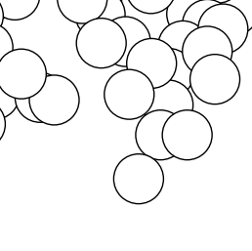
Alpha
Off-lattice simulation allows for overlapping between particles
The higher the alpha value, the larger likelihood of overlapping.
If two particle overlap to one another, the total area of two particle is smaller.
Notes:
This this changes in cluster is due to the overlapping of particles.
When we increase the alpha value, there are larger likelihood of overlapping.
So If two particle overlap to one another, the total area of two particle is smaller.

Slide 27
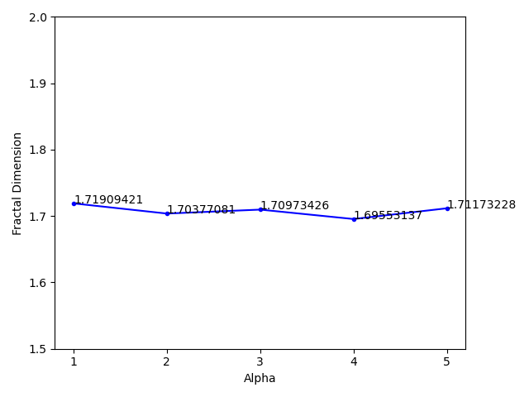
Alpha
The measured fractal dimension of all alpha value is close to each other.
Even if there are some fluctuations among these values. The standard deviation of these values is around 0.008, which is quite small.
Although visually the cluster is more constricted when we have a high value of alpha, the fractal dimension does not change with respect to the increase of alpha.

Slide 28
Thank you!
Questions?

